Slide 1
Ethical Hacking –task 2
Submitted by:
Devika S G

Slide 2
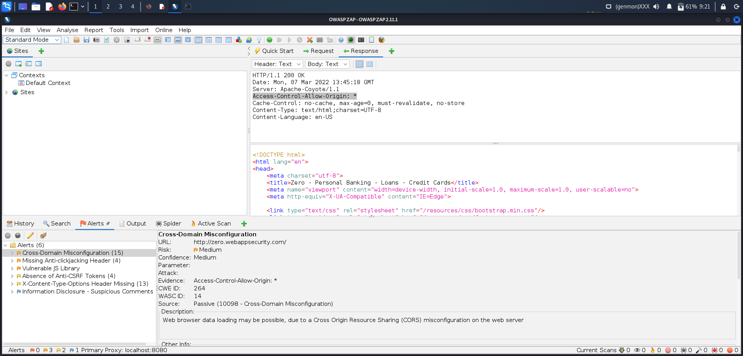
report

Slide 3
3 Vulnerabilities found are:
Cross-Domain Misconfiguration
Missing Anti-clickjacking Header
Vulnerable jS Library

Slide 4
Cross-Domain Misconfiguration (Report)
URL:http://zero.webappsecurity.com/
Risk: Medium
Description: There is a Cross Origin Resource Sharing(CORS) misconfiguration on the web server.
The misconfiguration allows cross-domain read requests from a 3rd party domain using
unauthenticated APIs.So this misconfiguration can be used by attackers to get the data in a
unauthenticated way but by still using different form of security like IP address white-listing.
Solution: We have to make sure the data is not available for the attacker in an
unauthenticated manner. We can either remove all the CORS headers or
configure the "Access-Control-Allow-Origin" HTTP header to use a more
restrictive domain rather than an unrestricted one. This will allow the web browser to enforce
the Same Origin Policy (SOP) in a restrictive way.

